Slide 1
IAC Conference’25 precise control of satellite rendezvous and docking maneuver using physics informed model predictive controller
Paridhi D Choudhary
21AE3AI02

Slide 2
Contents
Problem Statement
Traditional NMPC
PINN - MPC
Simulation Results

Slide 3
Problem statement
Satellite dynamics in unknown environments are inherently uncertain—due to factors like varying gravitational fields and atmospheric drag—posing significant challenges for precise and reliable control in mission-critical scenarios like spacecraft rendezvous and docking.
While Model Predictive Control (MPC) outperforms traditional controllers under dynamic conditions by optimizing trajectories in complex systems like spacecraft docking, its effectiveness heavily depends on the chosen prediction horizon—too short or too long can lead to suboptimal performance or computational inefficiency.
To overcome this, a PINN-based adaptive MPC framework is proposed, where system dynamics are embedded in the neural network and physical constraints are integrated into its loss function, enabling dynamic horizon adjustment and adaptability to changing environments.

Slide 4
Traditional nmpc used for satellite rendezvous and docking

Slide 5




Coupled dynamics of spacecraft relative motion
Attitude Kinematics:
Problem Setting:
Chaser Spacecraft must rendezvous with a tumbling uncooperative asteroid.
Chaser and target feature points (like grasper and rock are not at their centers, leading to kinematic coupling.
Relative Attitude Kinematics:
Relative Rotation matrix:
------(1)
Relative Attitude Dynamics:
Angular Velocity error:
------(2)

Slide 6


Coupled dynamics of spacecraft relative motion
Relative Translational Dynamics:
Since the feature points on both chaser and target are not located at their respective centers of mass, their relative position is given by:
------(3)

Slide 7
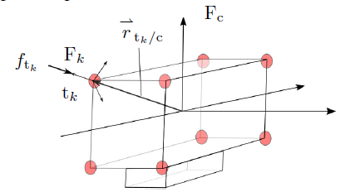
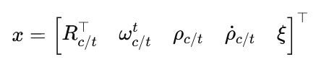
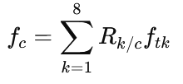


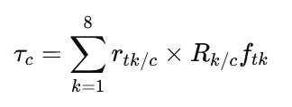

Thruster configuration and nmpc policy
Thruster Induced Dynamics Coupling:
8 gimballed thrusters produces both forces and torques.
Total force (in chaser frame):
Total Torque (about COM):
Non-Linear Model Predictive Controller:
Objective: Stabilize relative pose and velocity of chaser w.r.t target.
State Vector:
Control input:
Integral state dynamics for offset free tracking:
Full system dynamics:

Slide 8
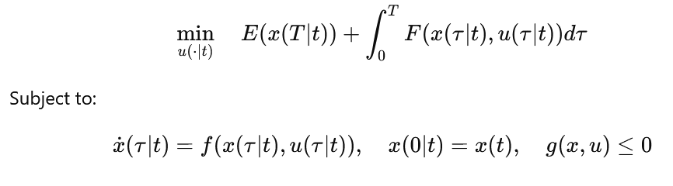
NMpc optimization problem and constraints
The cost function, composed of a stage cost integrated along the prediction horizon, and of a terminal cost expressed on the state at the end of the horizon
The chaser objective is for the feature point to reach and stay at the target, thus attaining zero position and attitude error, with translational and angular velocities matching the target.
Furthermore, in order to reduce the weight or increase the payload, the use of propellant should be minimized, which we formulate as minimizing the forces and the torques to be produced by the propulsion
system.

Slide 9



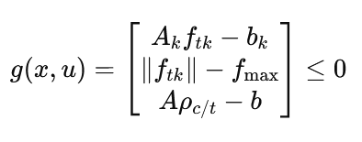
NMPC Constraints
Thruster Gimbal Constraints(Direction):
Each of the 8 gimbaled thrusters must point within a polyhedral cone (due to gimbal limits):
2. Thrust magnitude constraints :
Each thruster has a maximum force it can apply:
3. Line of Sight (LOS) Cone Constraint:
The line-of-sight (LOS) constraint imposes that the noncenter-
of-mass feature point on the chaser must remain in a
line of sight region of the target
4. Compact Notation for all the constraints:

Slide 10
Physics informed - mpc
Traditional NMPC Challenges:
Fixed Prediction Horizon -> suboptimal performance
Complex maneuvers need longer horizons (precision, stability)
Simple scenarios can use shorter horizons (computational efficiency)
Manual horizon tuning is scenario specific and non-adaptive.
Our solution: PINN-based Adaptive MPC that dynamically adjusts prediction horizon based on current system state and physics.

Slide 11
PINN Architecture
Input Layer: Current State [21×1]
├── Position error: ρᵗc/t (3)
├── Velocity error: ρ̇ᵗc/t (3)
├── Attitude error: Rc/t (9)
├── Angular velocity: ωᵗc/t (3)
└── Integral states: ξ (3)
Hidden Layers: [21] → [64] → [128] → [64] → [32] → [16]
Output: Optimal Horizon Nₒₚₜ
What makes it “Physics Informed”:
Not just the architecture – standard neural network architecture
Physics embedded in training process through loss function and MPC Simulation

Slide 12
Training process – the physics loop
Step 1: Horizon Prediction
N_predicted = PINN(current_spacecraft_state)
Step 2: MPC Simulation with Predicted Horizon
control_sequence, trajectory = solve_MPC(state, N_predicted) # This solves spacecraft dynamics
Step 3: Physics Informed Loss Evaluation
L_total = λ₁L_physics + λ₂L_performance + λ₃L_computational + λ₄L_safety
Where
L_physics : Dynamic Consistency= ||ẋ_predicted - f(x, u)||²
L_performance : Penalizes poor tracking performance = ||position_error||² + ||attitude_error||²
L_computational: Prevents unnecessary long horizons = α × N_predicted²
L_safety: Constraint satisfaction = Line-of-sight cone constraints + thruster limits

Slide 13
Simulation results

Slide 14
Thank you

